Slide 1
Practice 7
Windows Programming Languages

Slide 2
Practice 7 - 1
To-do List Programming

Slide 3
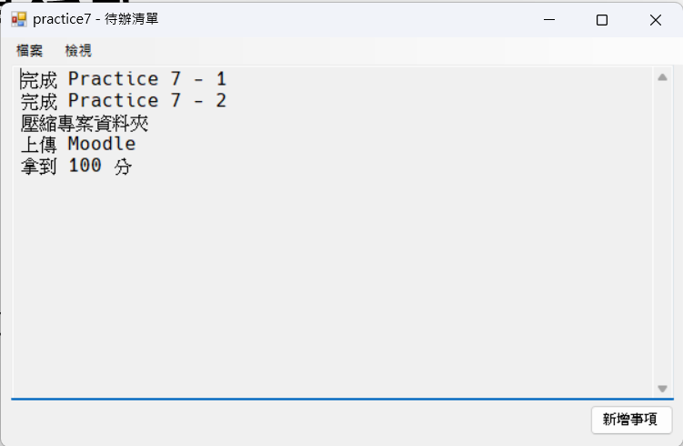
To-do List Programming
Implement the functions below:
Read in and Save
List Task
Add Task
Chang Font Size

Slide 4
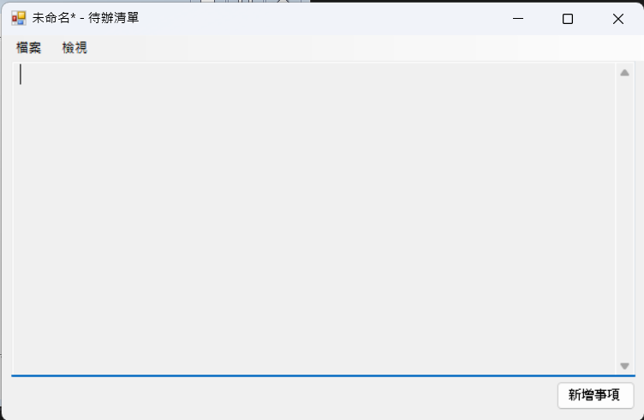
Initial Screen
There is a ReadOnly Textbox in the middle.

Slide 5
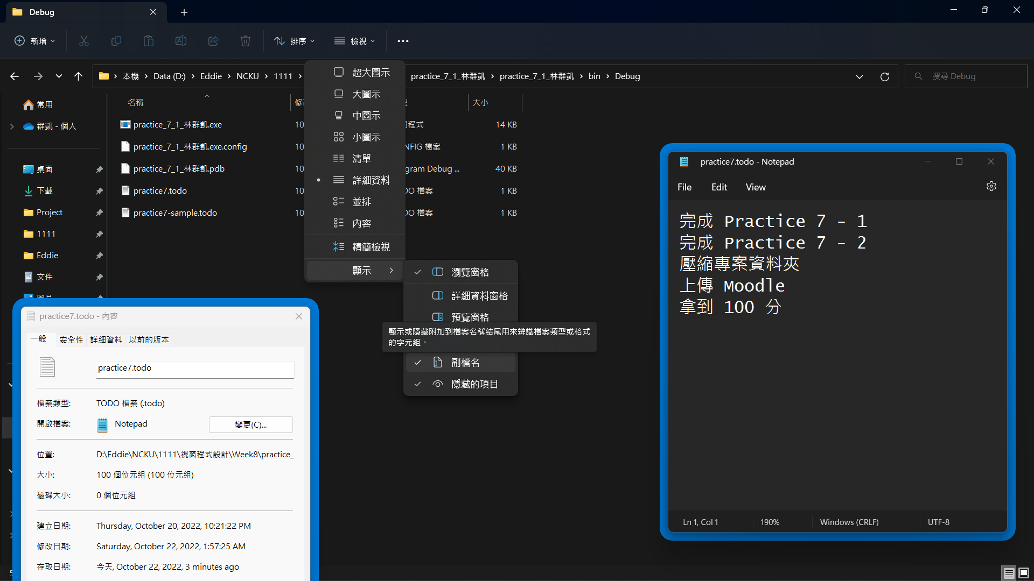
File Format
The file is saved as a text file with the .todo extension.
Each line of text represents an event.
Notice: It’s better to enable file extensions.

Slide 6
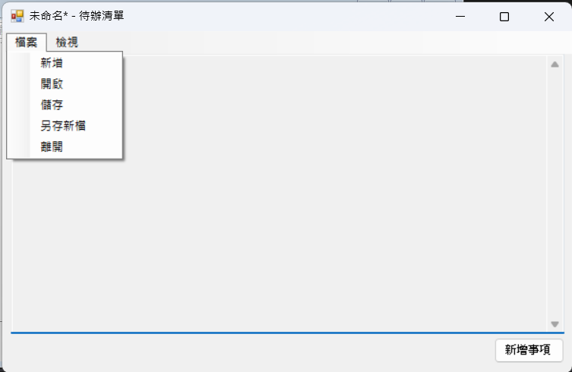
File Function
Five buttons should be listed on the drop-down menu after clicking the “File” on MenuStrip.
New
Open File
Save
Save as
Quit

Slide 7
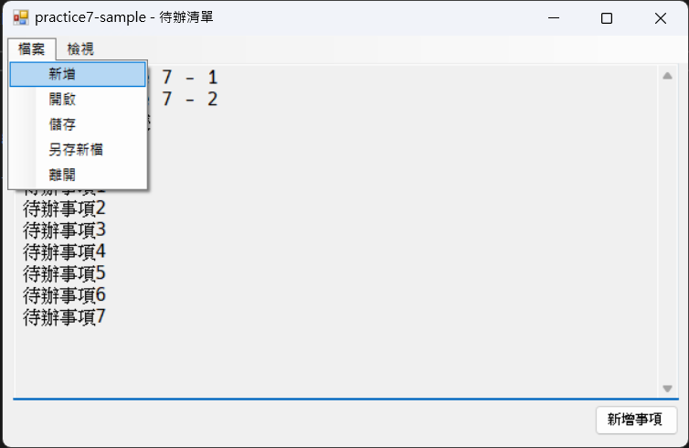
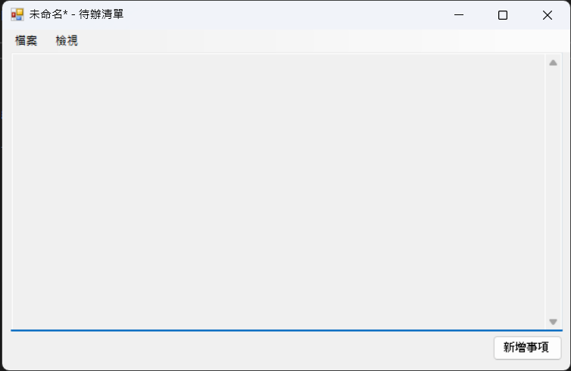
File Function - New
Press the “New” button, and the to-do list should be reset.

Slide 8
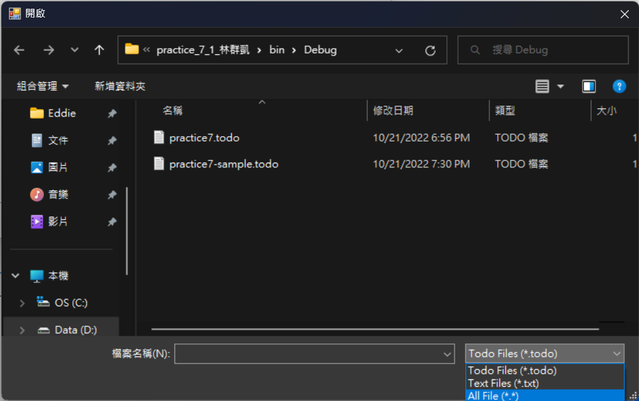
File Function – Open File
Select “Open File” and choose the file to read in.
3 kinds of filters to choose from:
*.todo
*.txt
*.*

Slide 9
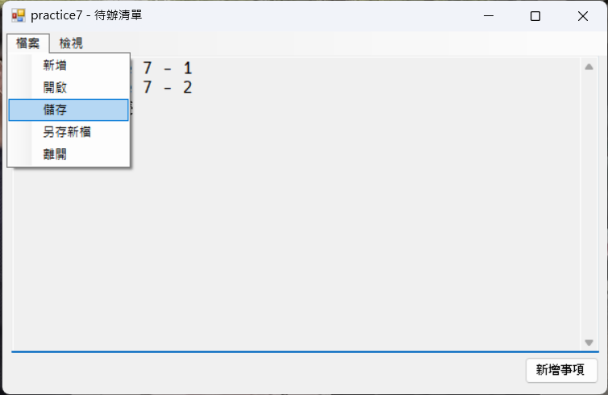
File Function – Save
Click “Save” to save the file.
If you open an existing file first, the original file will be overwritten when you select “Save”.
If you create a new file first, it will be saved as a new file when you select “Save”.

Slide 10
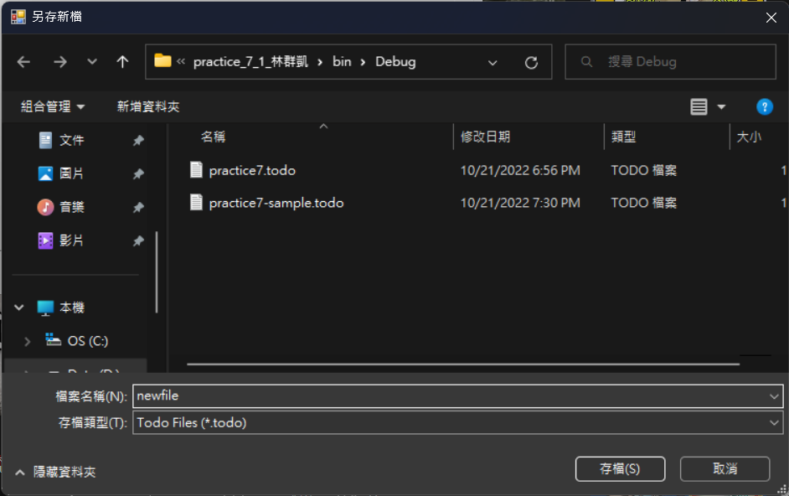
File Function – Save As
The data will be written in and saved as a new file.
Default file name extension is “.todo”.
3 kinds of filters to choose from:
*.todo
*.txt
*.*

Slide 11
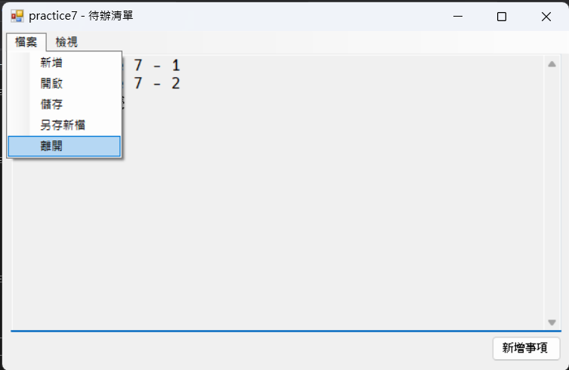
File Function – Quit
Select “Quit” to close the program.
If you don’t want to save the file, you may directly select “Quit” as well.

Slide 12
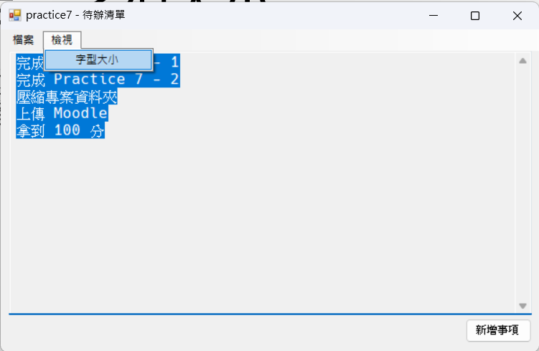
View Function – Font Size
Select “Font Size” to open Font Dialog to change the font size in Text Box.

Slide 13
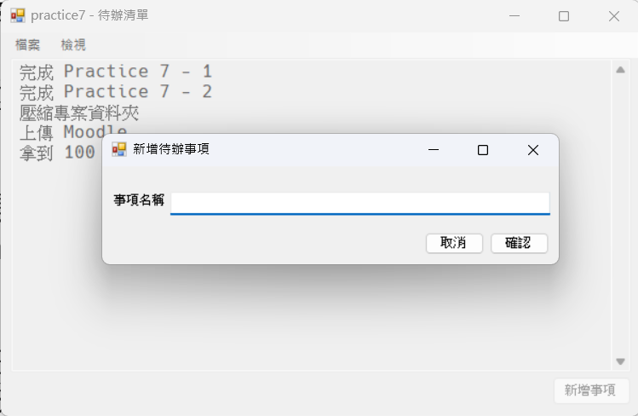
Add Task
Click “Add Task” button and a window should pop up to let you fill in the task name.
While the second window is opening, you should set the previous one to Enable = false.
Hint: The window will call the FormClosing event before it closes.

Slide 14
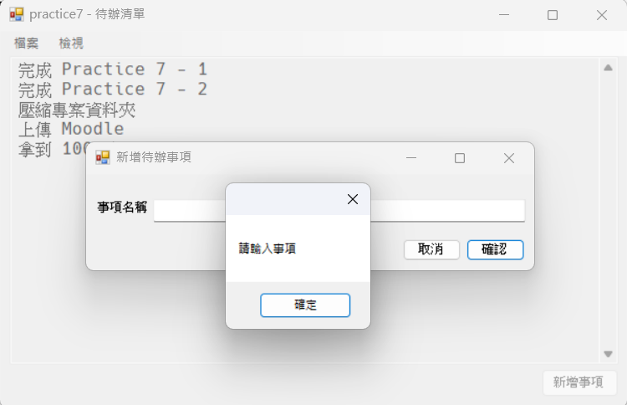
Add Task
Click ”OK“ and add tasks to the to-do list. Close the window of Add Task and return to the previous window.
If you do not fill in the task name but directly click “OK”, there should be a message saying “Please fill in the task name”.
Click “Cancel” to close the window of Add Task and return to previous window.

Slide 15
Practice 7 - 2
To-do List Programming

Slide 16
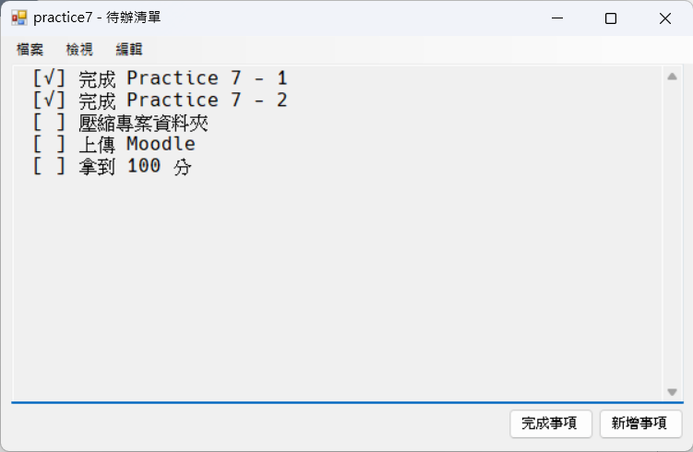
To-do List Programming
After you finish Practice 7-1, please increase the functions below:
Complete Task
Show/Hide Completed Task
Delete Task
Find Task

Slide 17
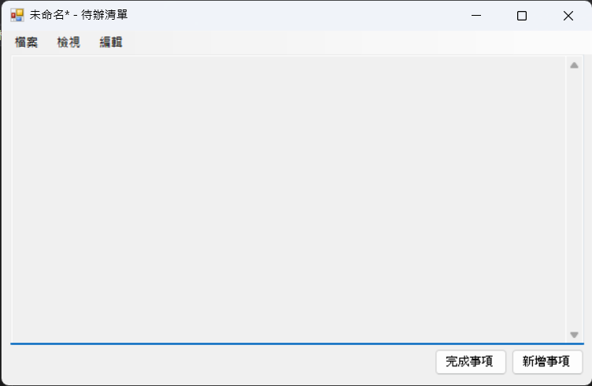
Initial Screen
There is a ReadOnly Textbox in the middle.

Slide 18
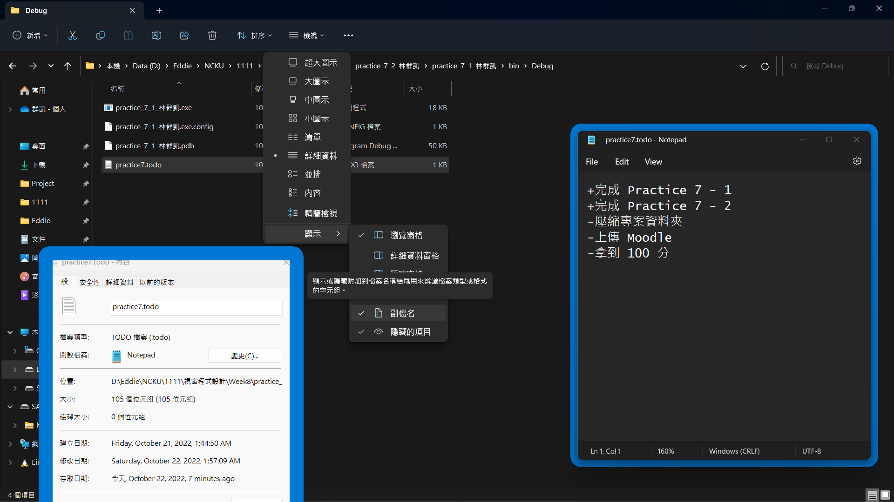
File Format
Compared to previous version, the first character of each line would be + or – and followed by task name.
+ means the task is completed.
- means the task is undone.

Slide 19
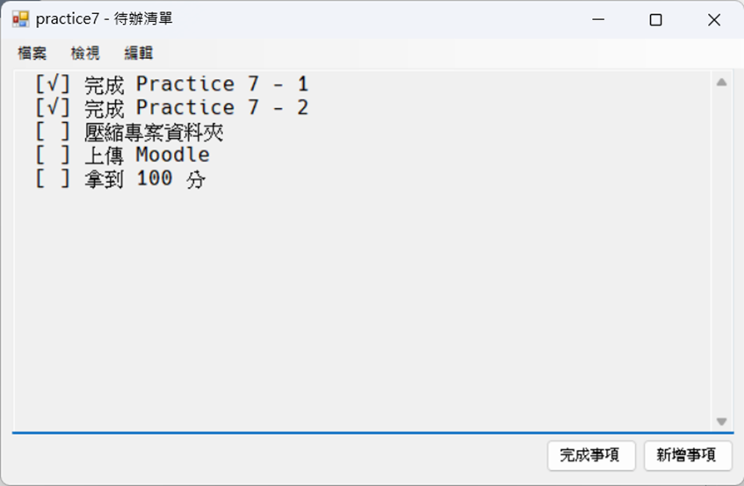
Show Task
The tasks are shown as follows.
“ [√] done Practice 7 – 1”
“ [ ] done Practice 7 – 2”
(<space>[√]<space><task>)
(<space>[<space>]<space><task>)
Notice: Do not output the character +/-.

Slide 20
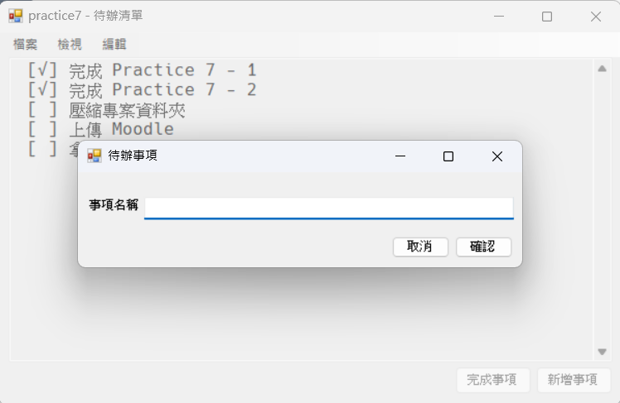
Complete Task
Click “Complete Task” and a window should pop up to let you fill in the task name.
Click “OK” and the corresponding task will show [√] if the task name is identical.
If the task name does not exist, just close the second window.
The other program behaviors are the same as previously mentioned.

Slide 21
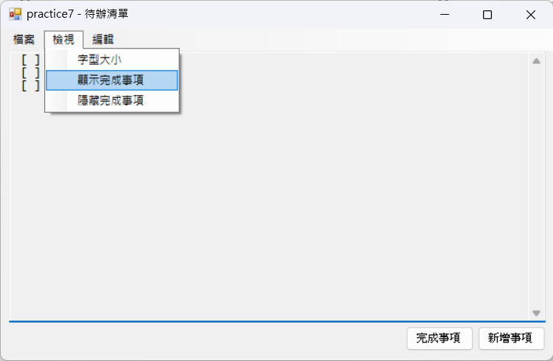
Show/Hide Completed Task
Select “Show Completed Task”, and all the to-do tasks will show.
Select “Hide Completed Task” and only undone tasks will be listed; the completed tasks will be hidden.
The program shows completed tasks as the default setting.

Slide 22
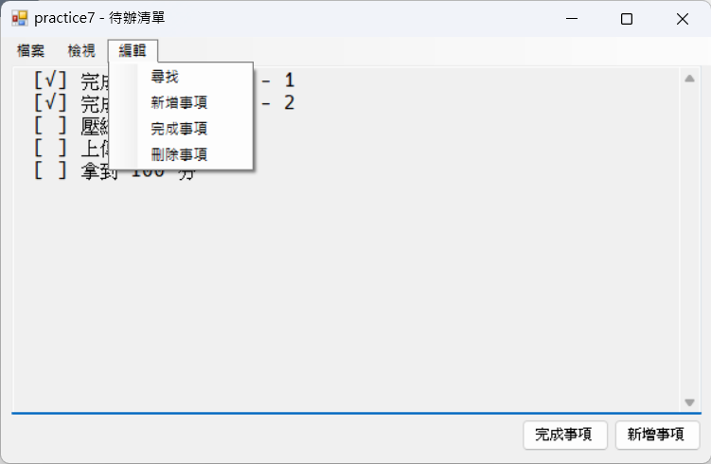
Edit Function
You can click “Add Task” and “Complete Task” buttons on the drop-down menu after clicking “Edit” which is the same as pressing the buttons in the bottom right corner.

Slide 23
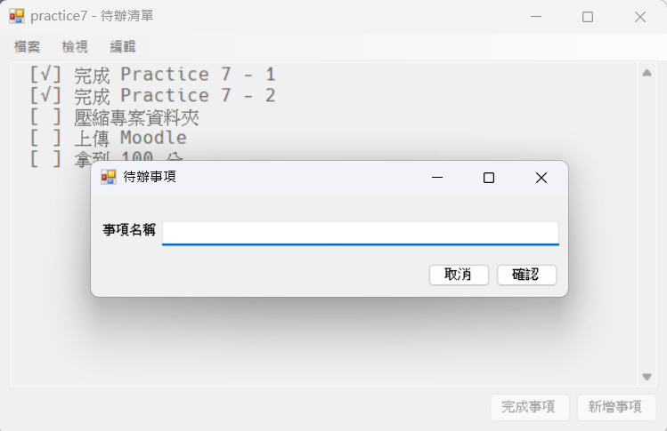
Edit Function – Delete Task
Click “Delete Task” and a window should pop up to let you fill in the task name.
Click “OK” and the task will be deleted if the task name is identical.
If the task name does not exist, just close the second window.
The other program behaviors are the same as previously mentioned.

Slide 24
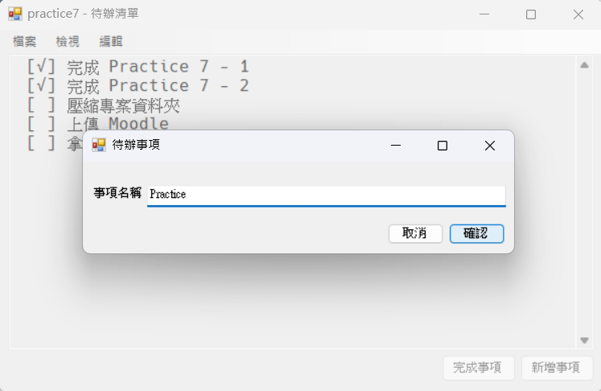
Edit Function – Find Task
Click “Find Task” and a window should pop up to let you fill in the task name.
All the task names containing the string will be listed.
If the task name does not exist in the list, the result is empty.
The other program behaviors are the same as previously mentioned.

Slide 25
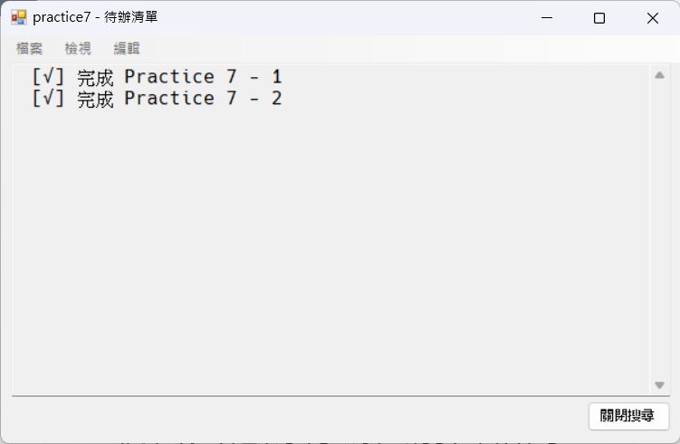
Edit Function – Find Task
When you list the search results, you need to set the MenuStrip at the top to Enable = false.
There should only be a “Close” button at the bottom.
Click “Close” to return to the previous settings.

